Slide 1
Blindside Sport | Nextgen Sport
Blindside
Scoring App
Sideline App
EPG-Online
Web App | Off Field
Mobile App | On-Field
Scout
Pro Suite
SARU
Footprint
E-Filing
Scoring App
Sideline App
Scout

Slide 2
NextGen Sport
ORG Type:
Governing Body (Region)
Governing Body (Tournament)
Members
Sports Code
World Governing Body
Type: Federation
GB.T – Celtic Rugby
GB.R– Rugby Africa
GB.R– Asia Pacific
Member Type:
Federation
Union
Etc
Company
Member(s) - Namibia
Member(s) - Kenya
Member - SARU
Country: NAM
Country: KEN
Country: ZA
Regional Member
Regional Associate
Regional Sub-Associate

Slide 3
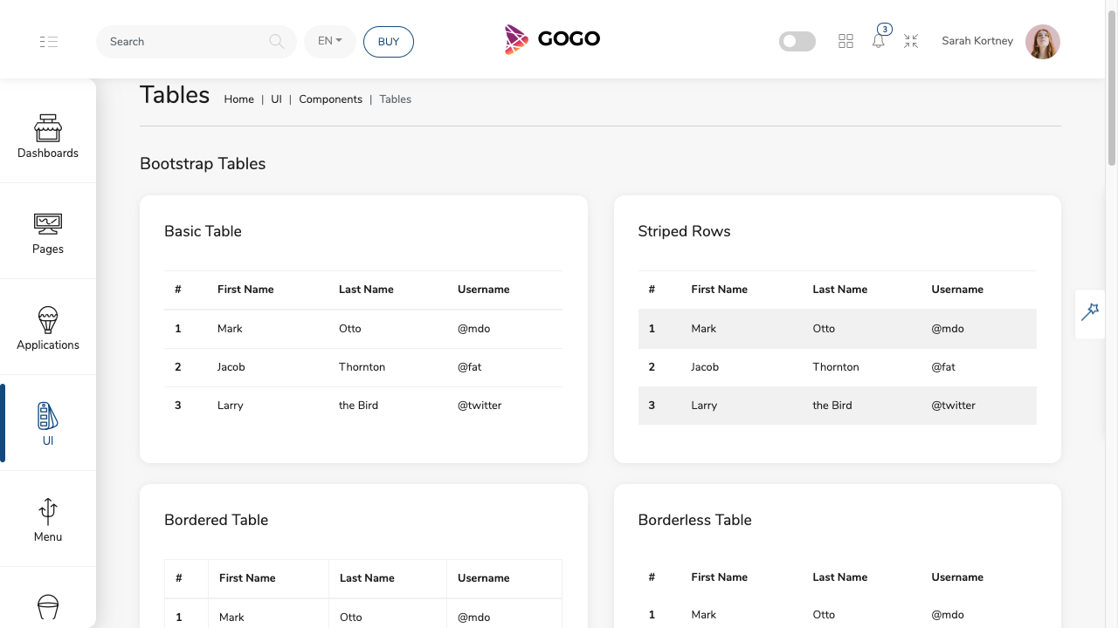
InSight
Organisation
Tournaments
Members

Slide 4
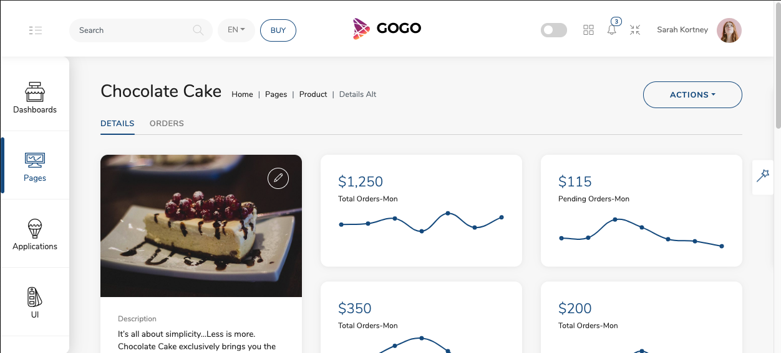
Base for Player/User profile

Slide 5
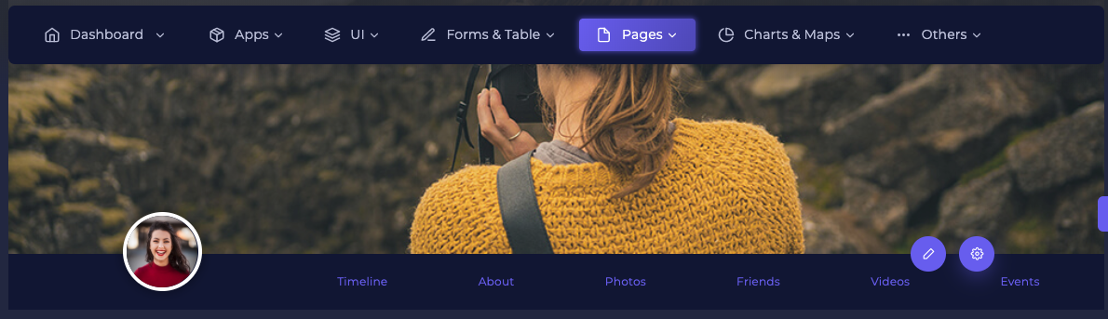

Slide 6
inSight – NextGen Sport
Org structure – multiple sports codes
  Upload EPG xls to system
  Form to complete EPG

Slide 7


Members (6)
- Dashboard
- Manage
- Transfers
- Scout
insight (2)
- Dashboard
- Surveys
Organisations (11)
- Dashboard
- Manage
- Reports
- Venues
- Surveys (KPI)
- Forms
- Plan & Budget
Tournaments (10)
- Dashboard
- Manage
- Fixtures
Squads (6)
- Dashboard
- Manage
- Assessments
Medical (4)
- Dashboard
- Injury Data
- BokSmart
- Surveys
- Library
Settings (8)
- Country
- Emails
- Roles
-
Library
- Manage

Slide 8



FOOTPRINTAPP
M. Von Brandis
inSight
Dashboard
Manage
Reports
Venues
Surveys (KPI)
Forms
Plan & Budget
Members
Organisations
Tournaments
Squads
Medical

Slide 9


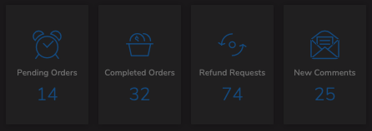
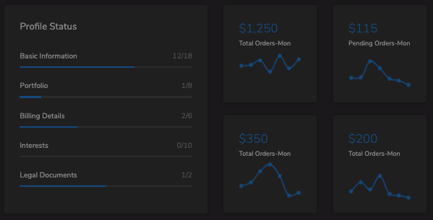
FOOTPRINTAPP
M. Von Brandis
inSight
BLUE BULLS RUGBY UNION
Dashboard Surveys Forms Venues Members & Affiliates
Members
Organisations
Tournaments
Squads
Medical

Slide 10
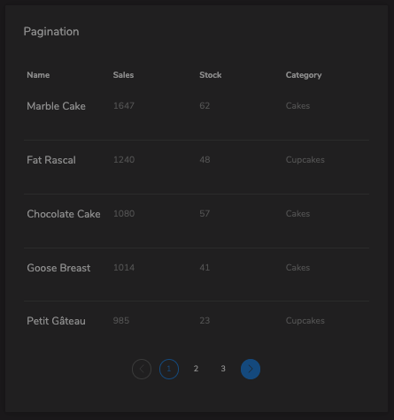
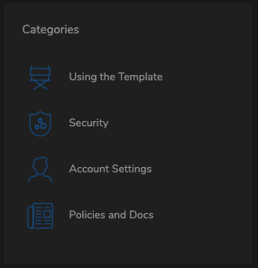
FOOTPRINTAPP
M. Von Brandis
inSight
Forms & Surveys
Members
Due Date
Type
Forms & Surveys
Organisations
Company Details
Company Information
Tournaments
Address & Contacts
Squads
B-BBEE & Documentation
Financials & Budgets
Medical

