Slide 1
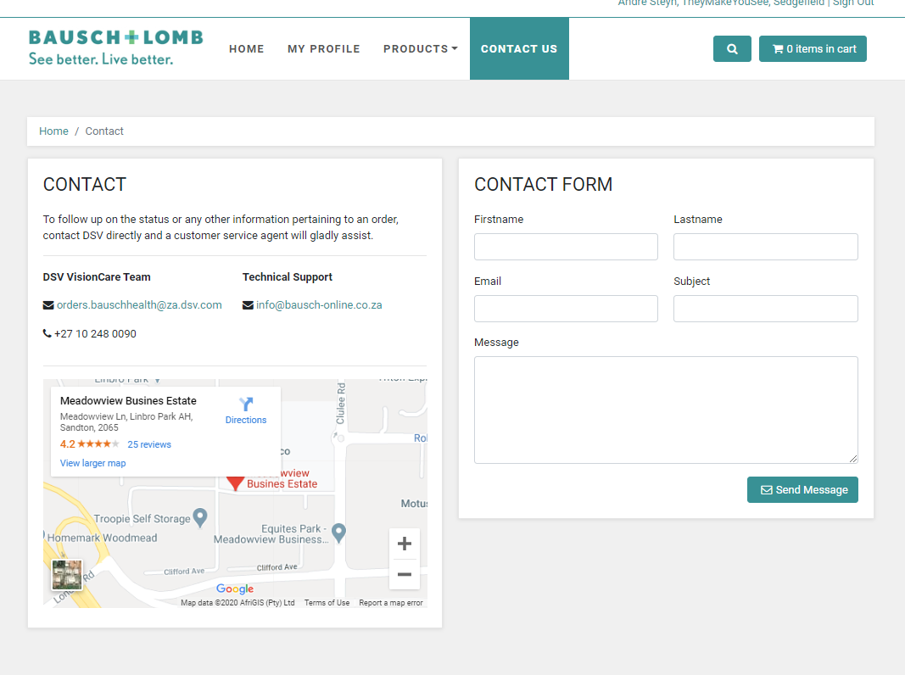
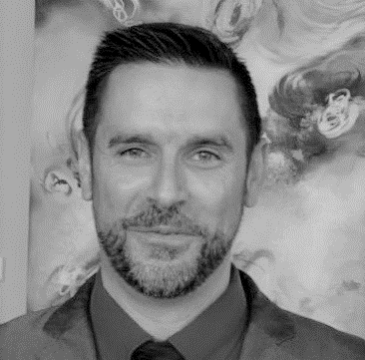
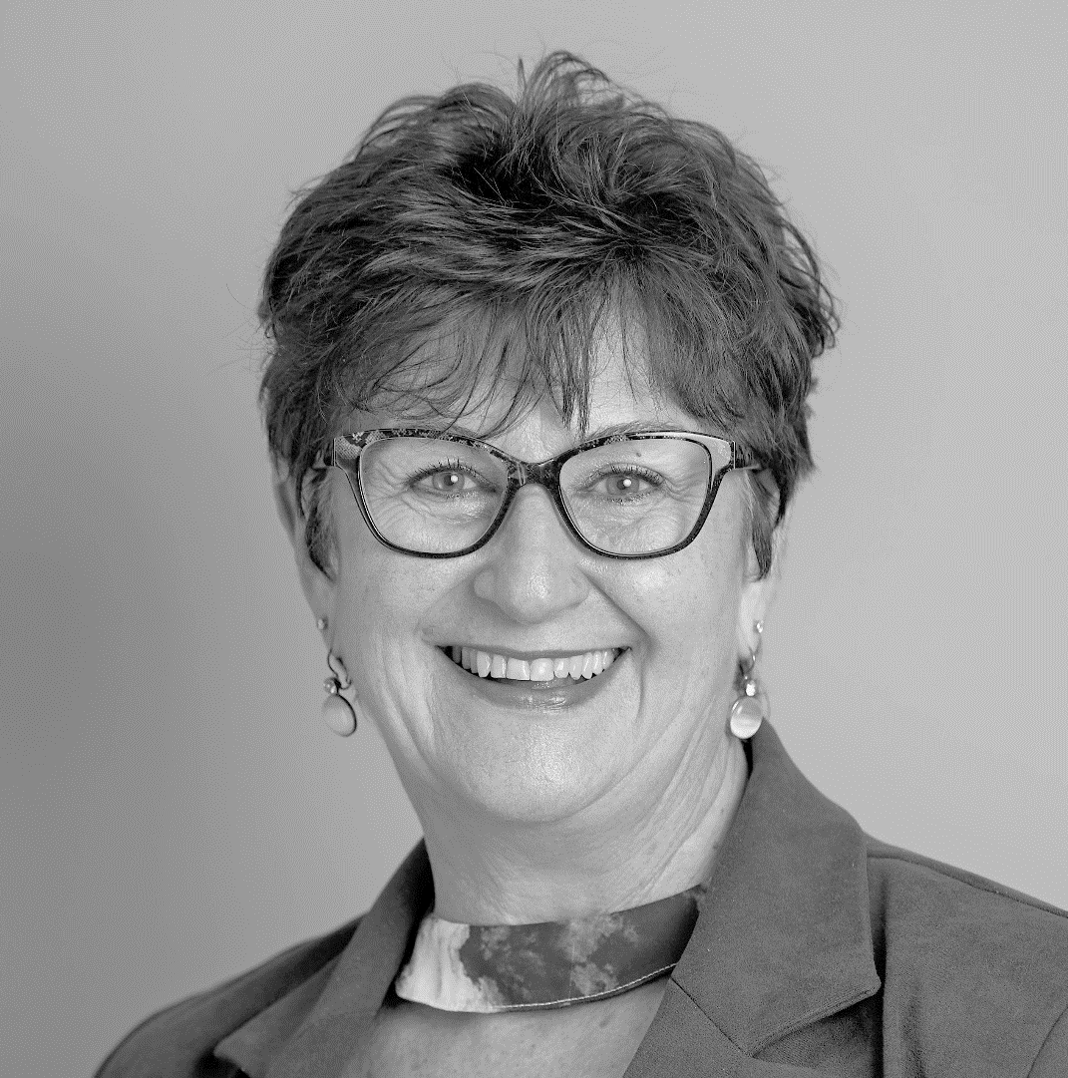
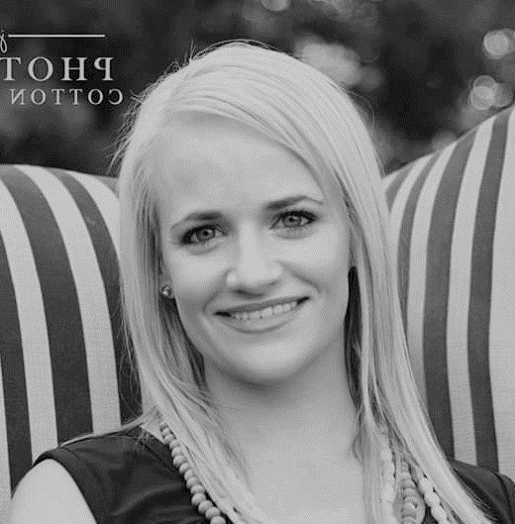
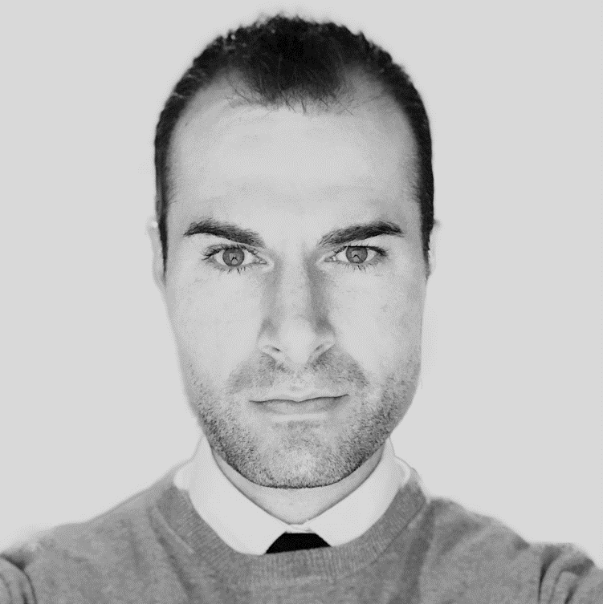
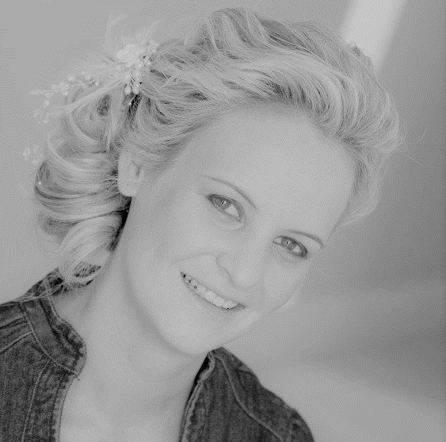
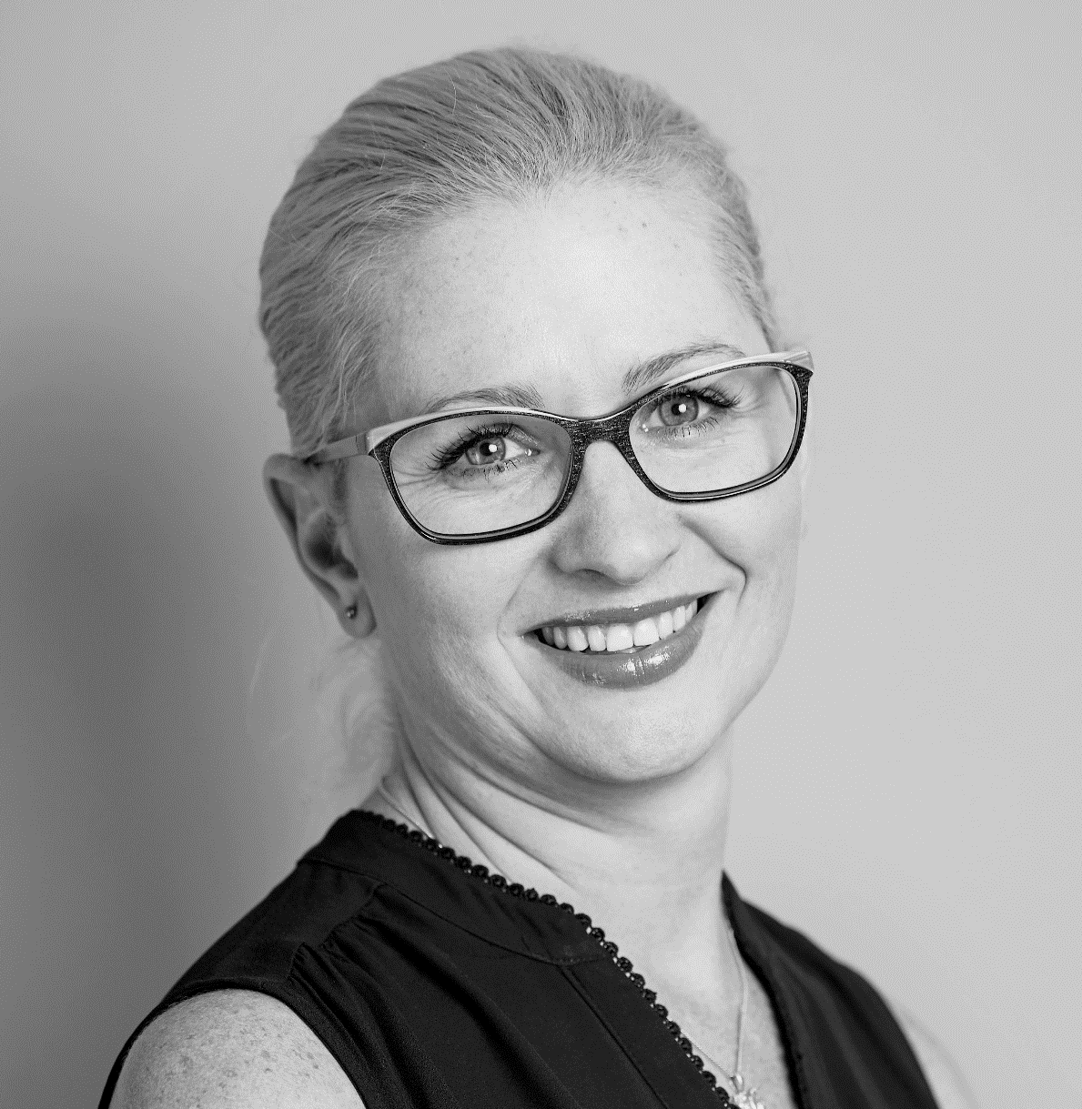
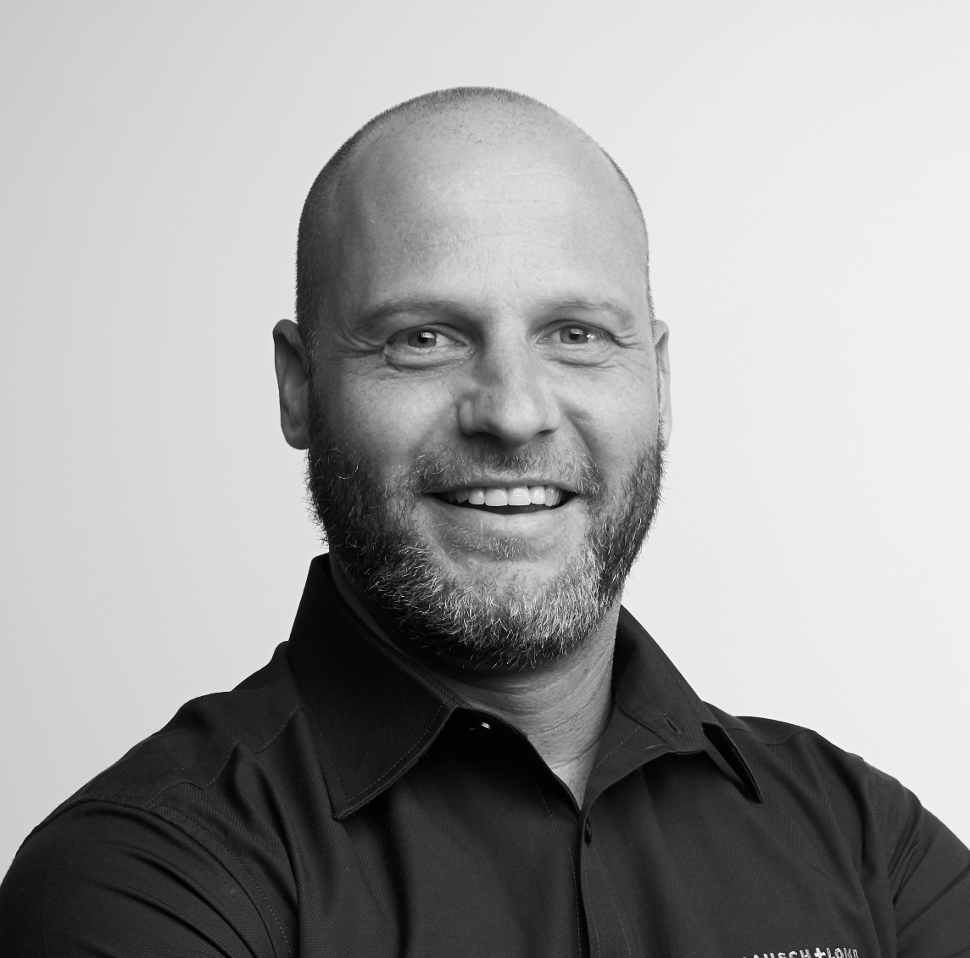
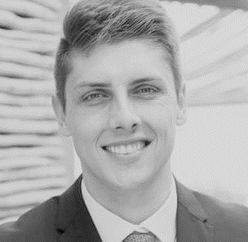
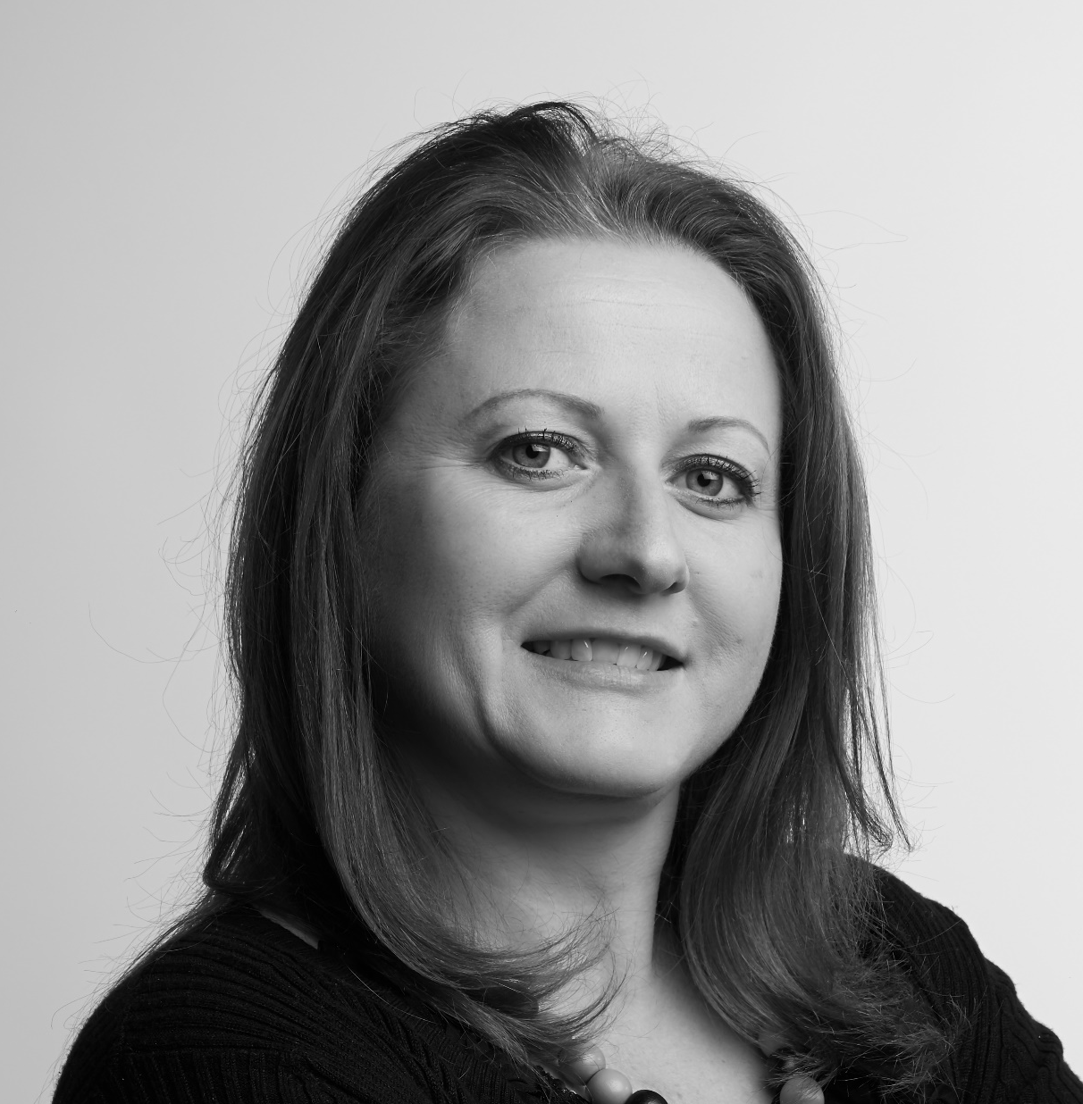
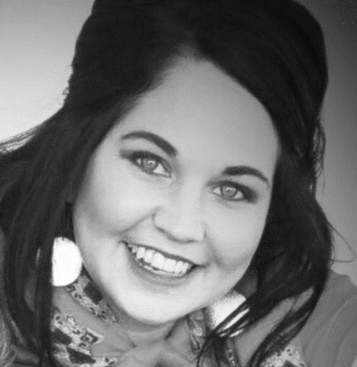
FIND A REPRESENTATIVE
JHB North
Jannus Benade
Jannus.Benade@bauschhealth.com
+27 71 688 2842
JHB East
Estelle Pretorius
Estelle.Pretorius@bauschhealth.com
+27 76 794 6399
JHB West/South
Corlize Geldenhuys
Corlize.Geldenhuys@bauschhealth.com+27 82 786 3652
Pretoria North
Albert Vermeulen
Albert.Vermeulen@bauschhealth.com
+27 83 252 5794
Pretoria East
Daneille van Straaten
Daneille.vanStraaten@bauschhealth.com
+27 84 588 6900
Kwa-Zulu Natal
Nikki Botha
Nikki.Botha@bauschhealth.com+27 72 208 7005
Cape Town Northern Suburbs & Surround
Christo Wolfaardt
Christo.Wolfaardt@bauschhealth.com
+27 72 465 7723
Cape Town Southern Suburbs & Garden Route
Clinton van der Schyff
Clinton.Vanderschyff@bauschhealth.com
+27 67 407 7534
Free State
Leonie Heymans
Leonie.Heymans@bauschhealth.com
+27 79 763 1451
Eastern Cape
Heidi Koekemoer
Heidi.Koekemoer@bauschhealth.com
+27 83 669 5695

